Slide 1

SW Digital
Performance Management for Start-Ups – done securely

Slide 3
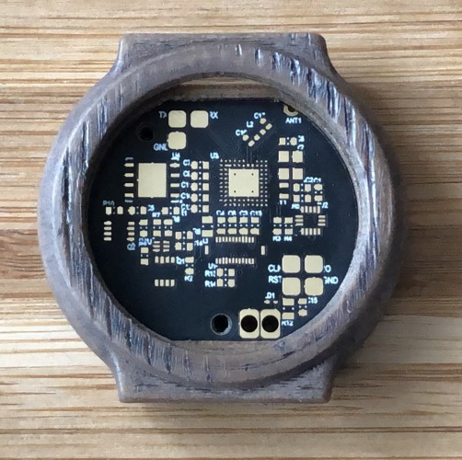



What do we sell?
Invincible fortress of high security
Extremely transparent
Very affordable

Slide 4
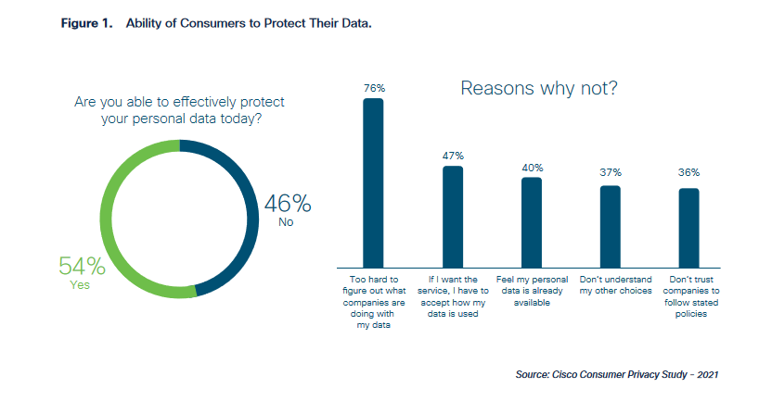
To whom do we sell?

Slide 5


To whom do we sell?

Slide 6
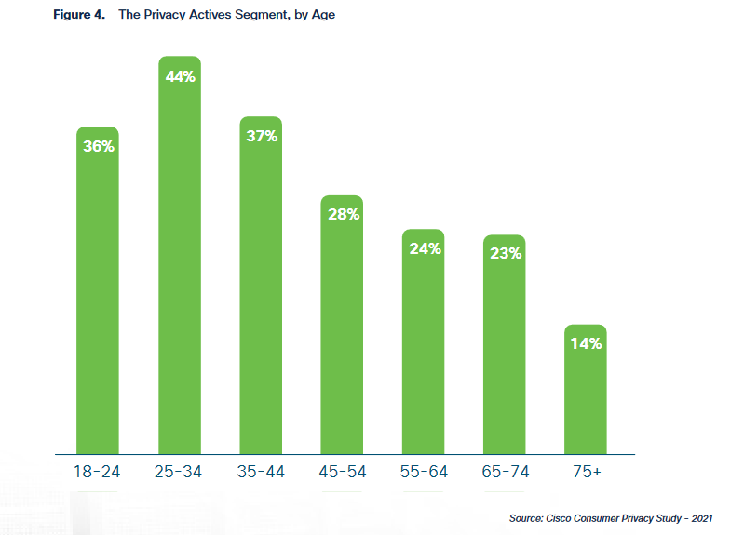
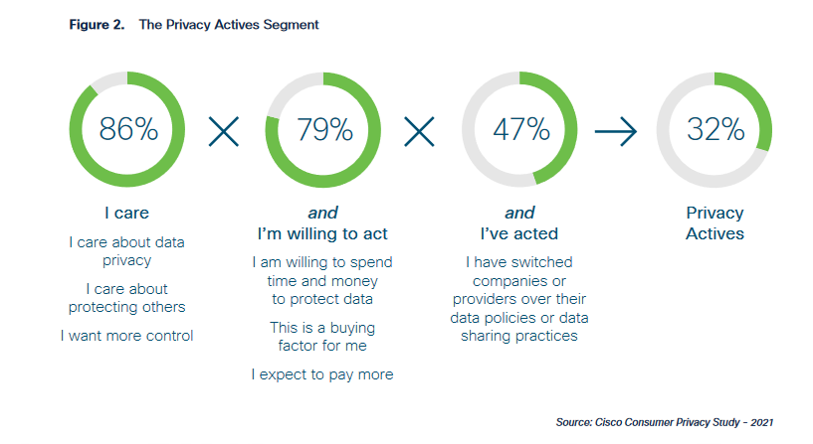
To whom do we sell?

Slide 7




Typical Customer
Fitness/Health Aware
Data Privacy
Young

Slide 8
Key Partners:
App Stores
Key Suppliers:
Ali Express
Research and Development: Developing the technology that goes into the smartwatch and ensuring that it provides a high level of data protection will be a critical activity.
Data Security: Implementing robust data security measures to ensure that the smartwatch can keep user data safe will be a core activity.
Manufacturing: Building the smartwatch and ensuring that it meets the required quality standards and is delivered on time will be an essential activity.
The demand for data privacy is a market that is quickly emerging from a niche to a mass market. Especially, in the area of sensitive data.
The biggest segment are however technically competent customers.
We aim to build a community that has a strong desire for data privacy. Furthermore, we encourage the community to build apps for the smartwatches.
Data Protection: The primary value proposition of our smartwatch is its ability to protect user data. By implementing robust data security measures, we provide customers with peace of mind that their personal and sensitive data is safe from hacking, theft, or other types of data breaches and data selling. This is our main value proposition that differentiates us from competitors.
Convenience: Smartwatches are highly portable and convenient, allowing users to access data and information quickly and easily from their wrist. By providing a user-friendly interface and easy-to-use features, we offer customers a hassle-free experience.
Health and Fitness: Smartwatches can track a user's health and fitness metrics, including heart rate, steps taken, and calories burned. By incorporating health and fitness features into our smartwatch, we appeal to customers who are interested in monitoring their physical activity.
As all apps nowadays are being distributed through App Marketplaces, these Marketplaces are important partners.
We want to partner with all marketplaces to diversify the risk.
Our key supplier is Ali Express, this should not be a big risk as it would be easy to subsidy and maybe produce directly as soon as we have enough demand.
Key Resources:
Funding, Data Security Expertise, Raw Materials and Components
Distribution Channels:
Online Store and Influencer Marketing, Ads
Revenue Streams:
Smart Watch Sales, Potential App Premium, Potential Licensing on a larger Watch Producer
At first Online Marketplace.
The smart watch components and is manufacturing are the most expensive resources. Those costs are however mostly variable. In the beginning we will have very little fixed costs besides our salaries.
The software is extremely scalable and does not become more expensive when selling more watches. Another costly activity are the ads and technical influencers that should promote our smartwatch.
The customers dominantly pay for the smartwatch value combined with the protection of their sensitive data. The smartwatch can be bought for a fixed price which will also include its software and updates, further improving the customer relationship by generating total clarity.
In the future special proprietor app features could be sold by a premium.

Slide 9

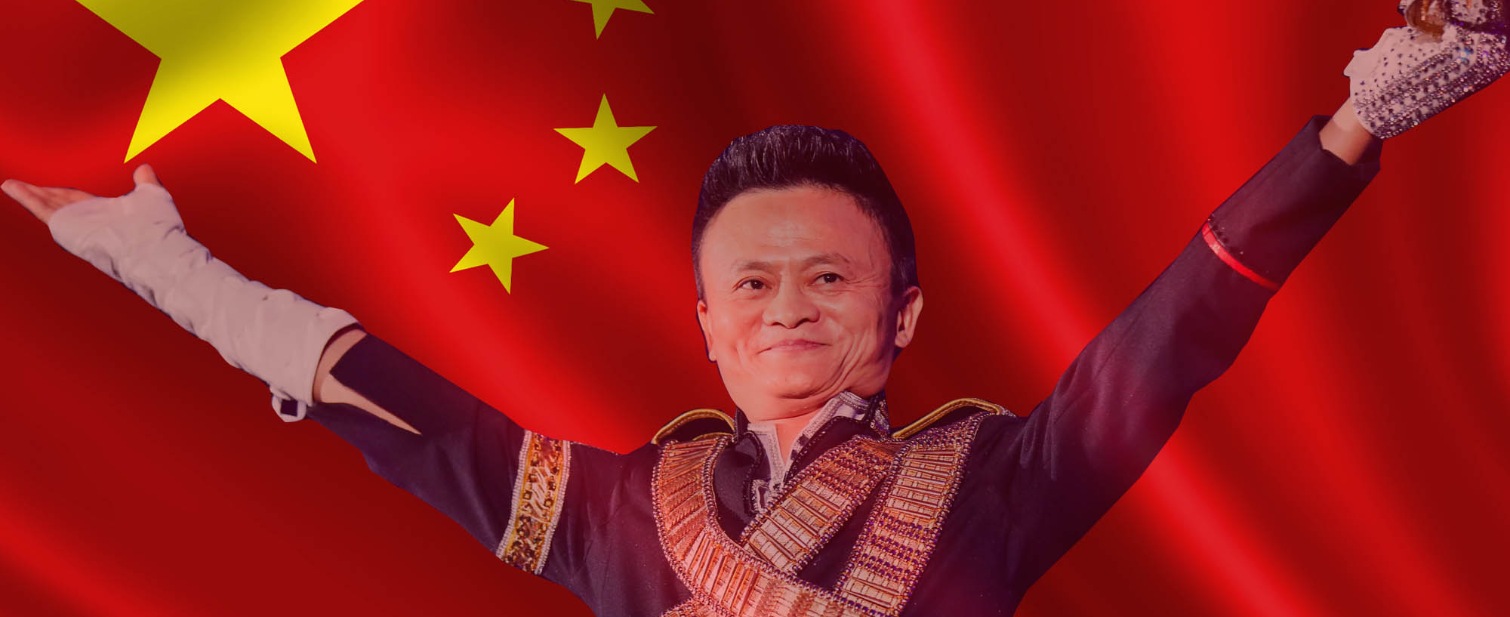
Key Partners & Supplier

Slide 10






Key Activities Key Resources
Development
Data Security
Manufacturing
Data Security Expertise
Components
Developers

Slide 11
Customer Relationship & Channels
Community
Co-Creation
Online-Shop

Slide 12
Revenue Streams
Device Sales
Third Party Fees
Notes:
Financial View

Slide 13
Innovation, Innovation and Innovation
Joint-Venture
Notes:
Financial View

Slide 14








Break-Even
Joint Venture
ready
Smartwatch 2.0
Mass Production
Third-Party Store
Mobile Integration
Smartwatch
Fitness/Healthcare
Apps
t

Slide 15
When will we reach profitability?
How much capital will we need to reach profitability?
How much will we invest to get the product ready?

Slide 16
How much does our first customer costs?
What is the expected contribution margin per customer?
Notes:
Financial View

Slide 17
Metrics
Metrics, indicators or factors to be routinely monitored
House of Performance Cockpit
→ Going through the lecture slide and use the concepts

Slide 18
Merge Ready
Financially Stable

Slide 19




Gain Capital Financial Stable Cost Control
Awareness Contribution & Commitment Demand on Security
Security First OpenSource Education Efficiency & Excellence
Brand Popularity Merge Ready Benchmark Competitors

Slide 20


Key Results to be Merge Ready
Increase Website-, Blog-traffic and Community
by +15%/month
Implementation of at least 10% from Open-Source-Functions into our Developments
At least 1 Certification/Year/Employee
Certified Information Systems Security Professional (CISSP), Certified Information Security Manager (CISM), Certified Ethical Hacker (CEH)

Slide 21

Key Results to be Financial Stable
Reduction in Hardware Production
of -5%/month down to 10
Warranty & Security Claims (SW & HW)
less than 4%/month
Inventory Turnover Ratio for JIT Inventory
1 Year ⌀ 0.5
2 Year ⌀ 2
3 Year ⌀ 10
Notes:
Sold Product / Incentory = 100 / 200 = 0.5
Sold Product / Inventory = 100 / 50 = 2
Sold Product / Inventory = 100 / 10 = 10

Slide 22

Personnel
3 Founders +1FTE starting in 2026
1 FTE = CEO & CFO , and Developer
1 FTE = CTO and Chef Developer
1 FTE = COO and Developer
+1 FTE = Investment, Deal and Exit Manager

Slide 23

Organization
Holocracy and Agile Management
with a strong focus on Open Source Community
Interactions over processes and tools
Working software over comprehensive documentation
Customer collaboration over contract negotiation
Responding to change over following a plan

